Slide 1
Exit Test Project
Name – Saim Hur Hasan
Personal Number - 3192898

Slide 2
Problem Statement
The problem statement is a product catalogue website where a customer can visit, register themselves, browse products, search products, view product details.

Slide 3
First application (REST API – No UI, only backend): User authentication API Build a Rest API to support successful/unsuccessful user authentication validation. User registration API Build a Rest API to register new users. Search product API Build a Rest API to search a product by one or many of the following parameters: Name Product code Brand Product Details API Build a Rest API to get other details such as description for product Get Price API Build a Rest API to get prices for a product or list of products. Get Serviceability API Build a Rest API to check if a product is serviceable/deliverable to a certain pincode and what is the expected delivery time
2 applications are to be developed

Slide 4
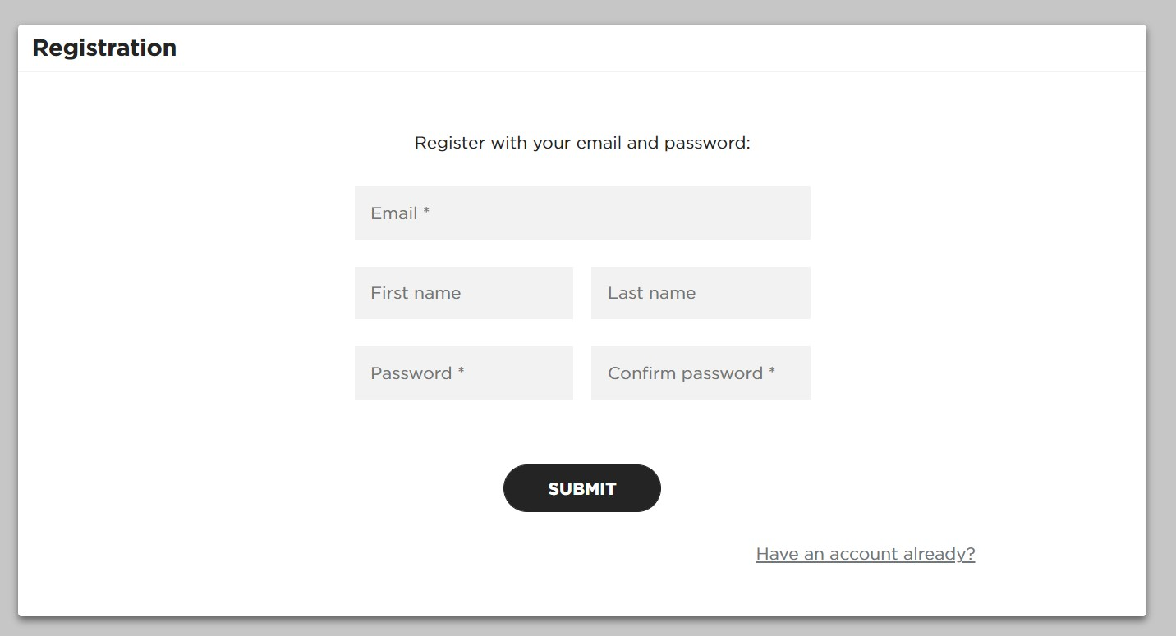
Homepage Landing page should have links for Registration and Login. Homepage should show a search box with which a customer can search for a product. Login Page The application should have a login page. User should be able to login. Proper error messages should be handled in case of invalid authentication. Registration Page The application should have a registration page. User should be able to register. Validation for email address, password policy, mandatory fields such as name etc. should be performed.
Second Application (using Angular):

Slide 5
Product search page.
Search screen should search the input text against all input parameters specified for matching products
Results Page.
Once Search is triggered after specifying the search parameters, It will display the search results using the API from 1st Application.
The search results should display product image, name and brand
The user should be able to see the products and filter them further by brand.
If a customer is logged in,
they should be able to view prices of every product in the search results
they should be able to click on view details link on every product
they should be able to filter products by price range
If no results are found, error messages should be displayed.
Product details page.
Logged in users can view product details by clicking on view product details link from search page.
The product details page should show product image, product name, description, brand, price and a textbox to check serviceability
Logged in user can enter their pincode in the textbox to check serviceability. Once they click on submit, they should get a proper message whether the product can be delivered to their pincode or not and what is the expected delivery time.
Logout
User should be provided with an option to logout.

Slide 6
Solution

Slide 7
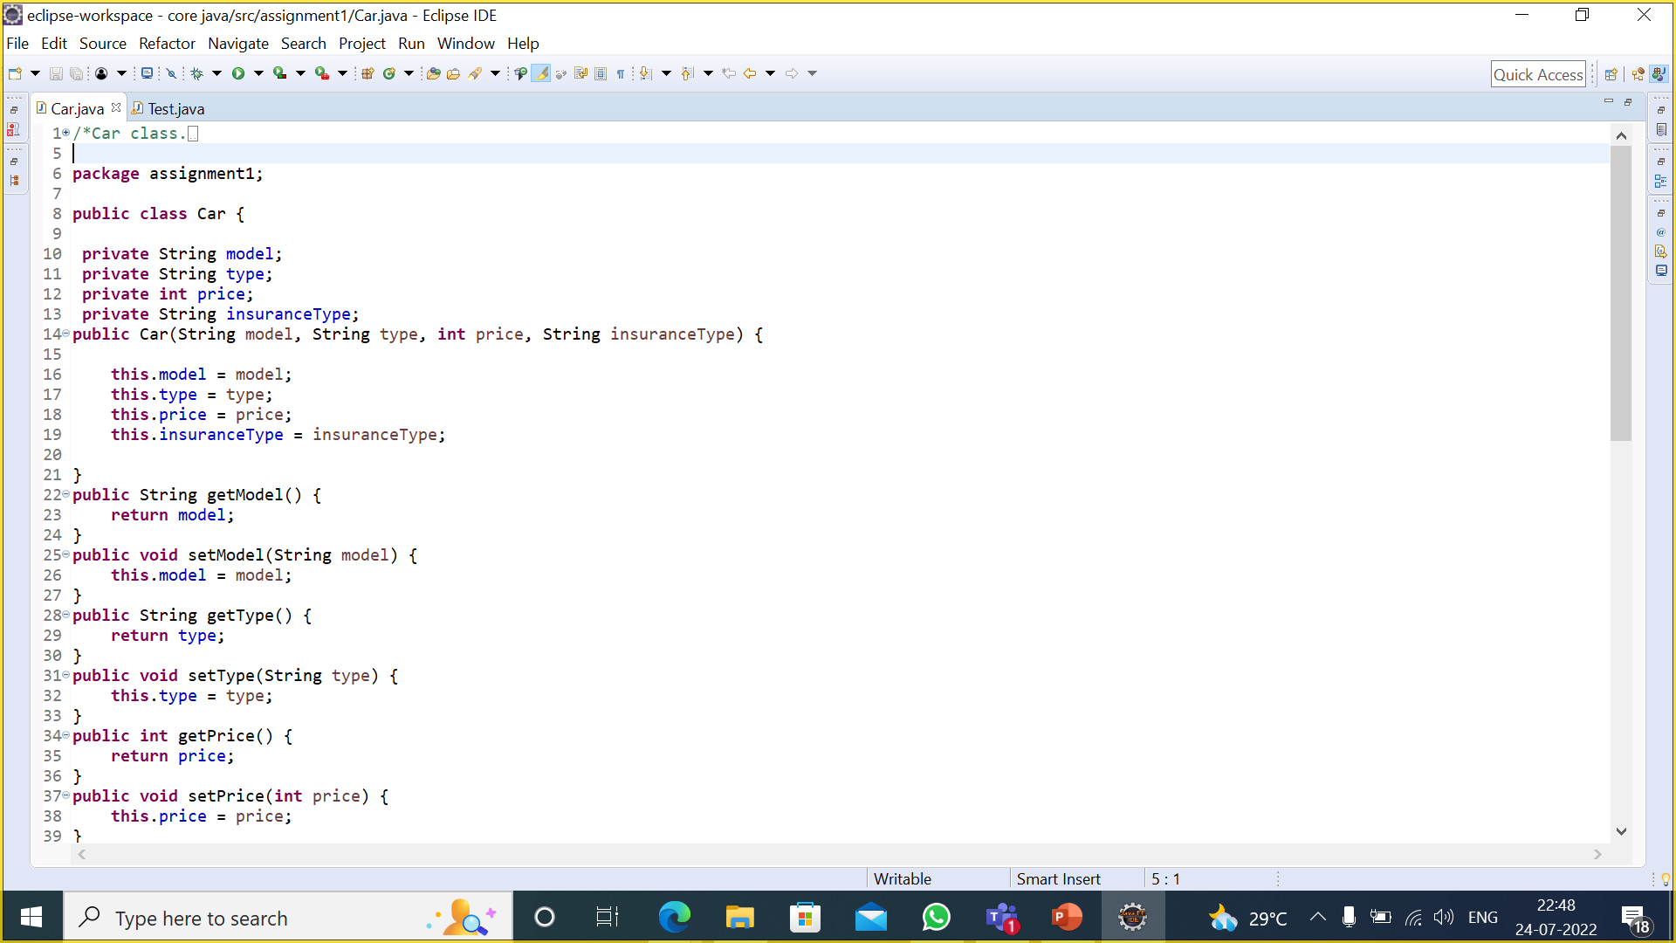
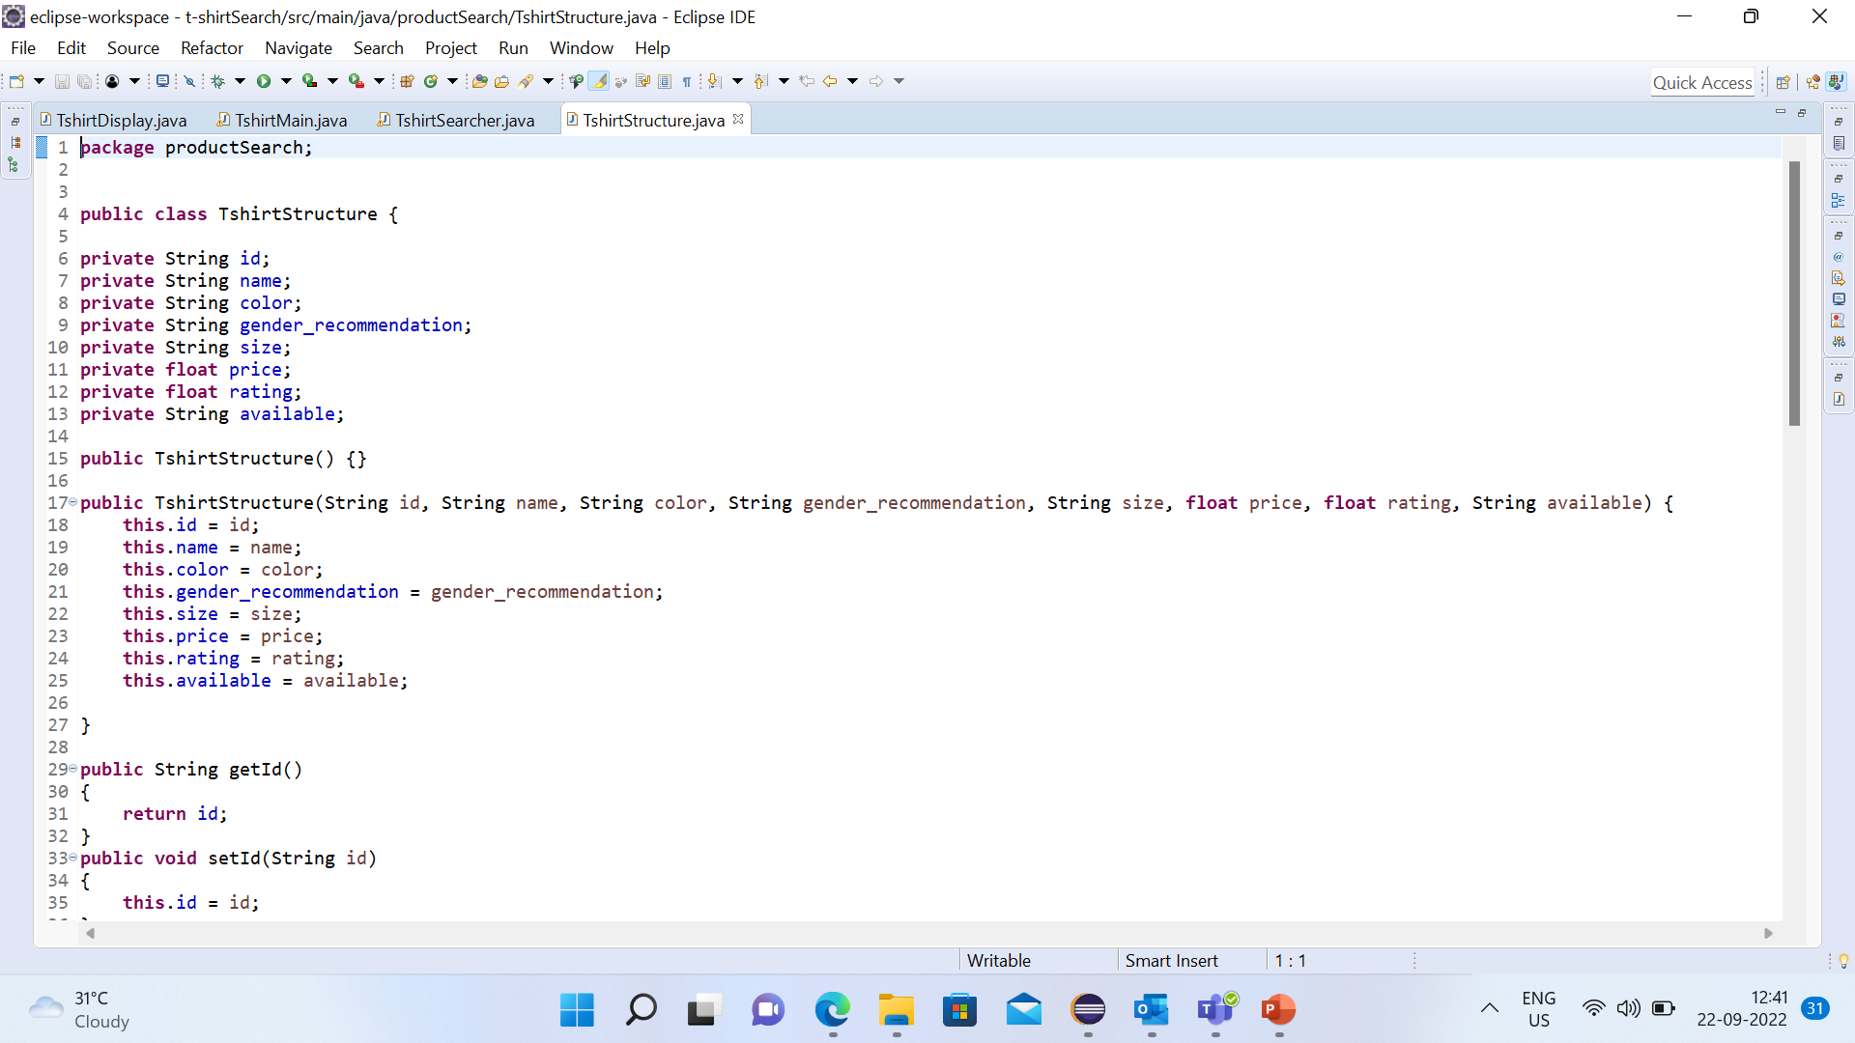
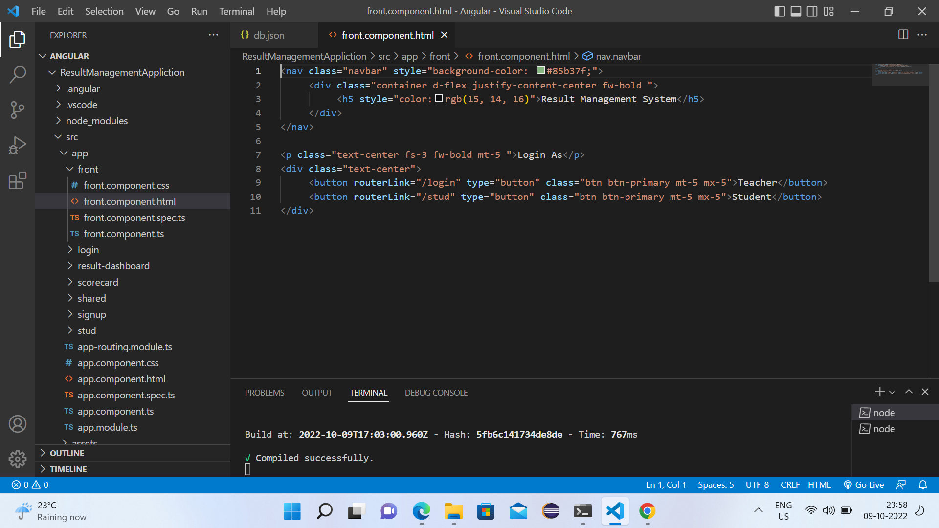
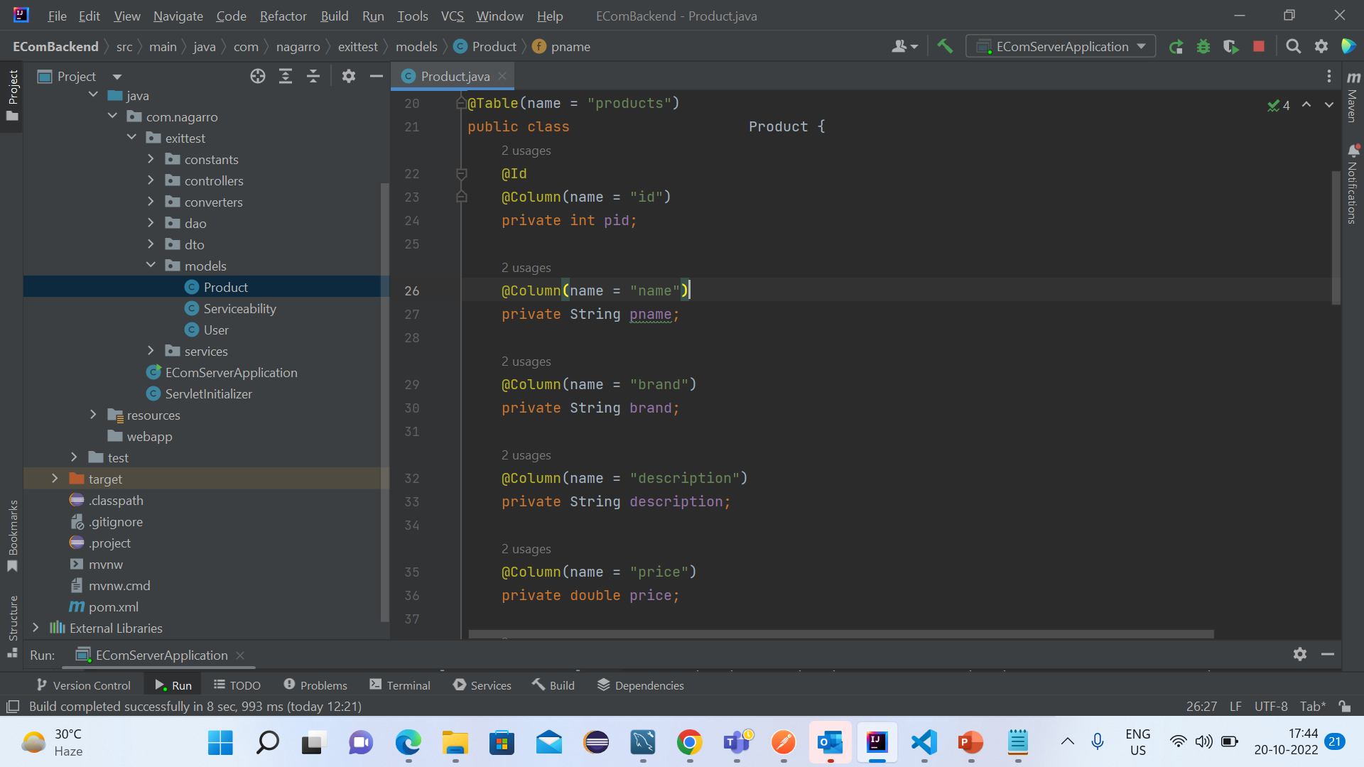
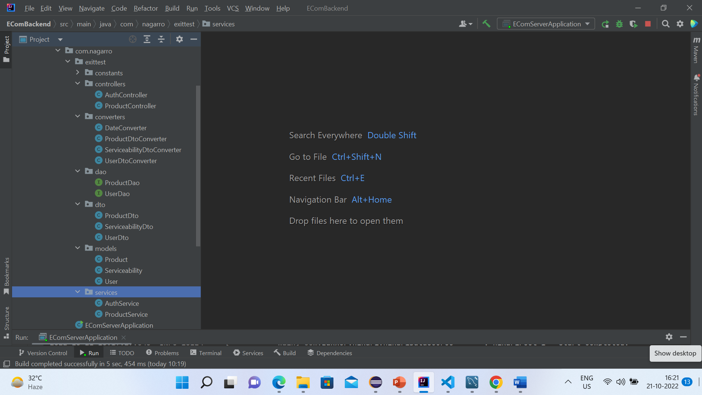

Slide 8
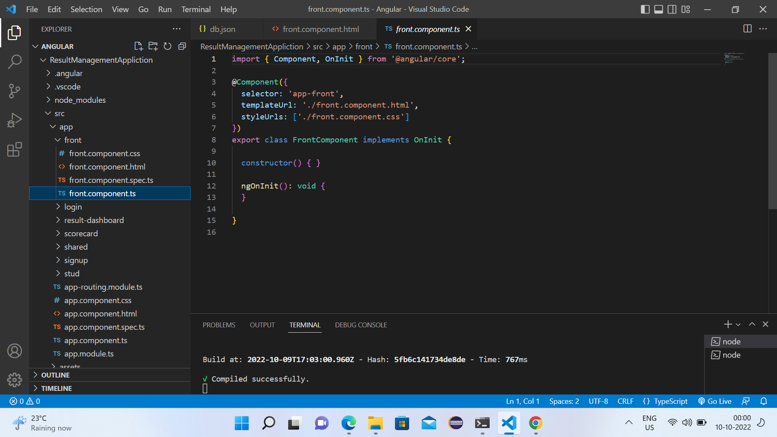
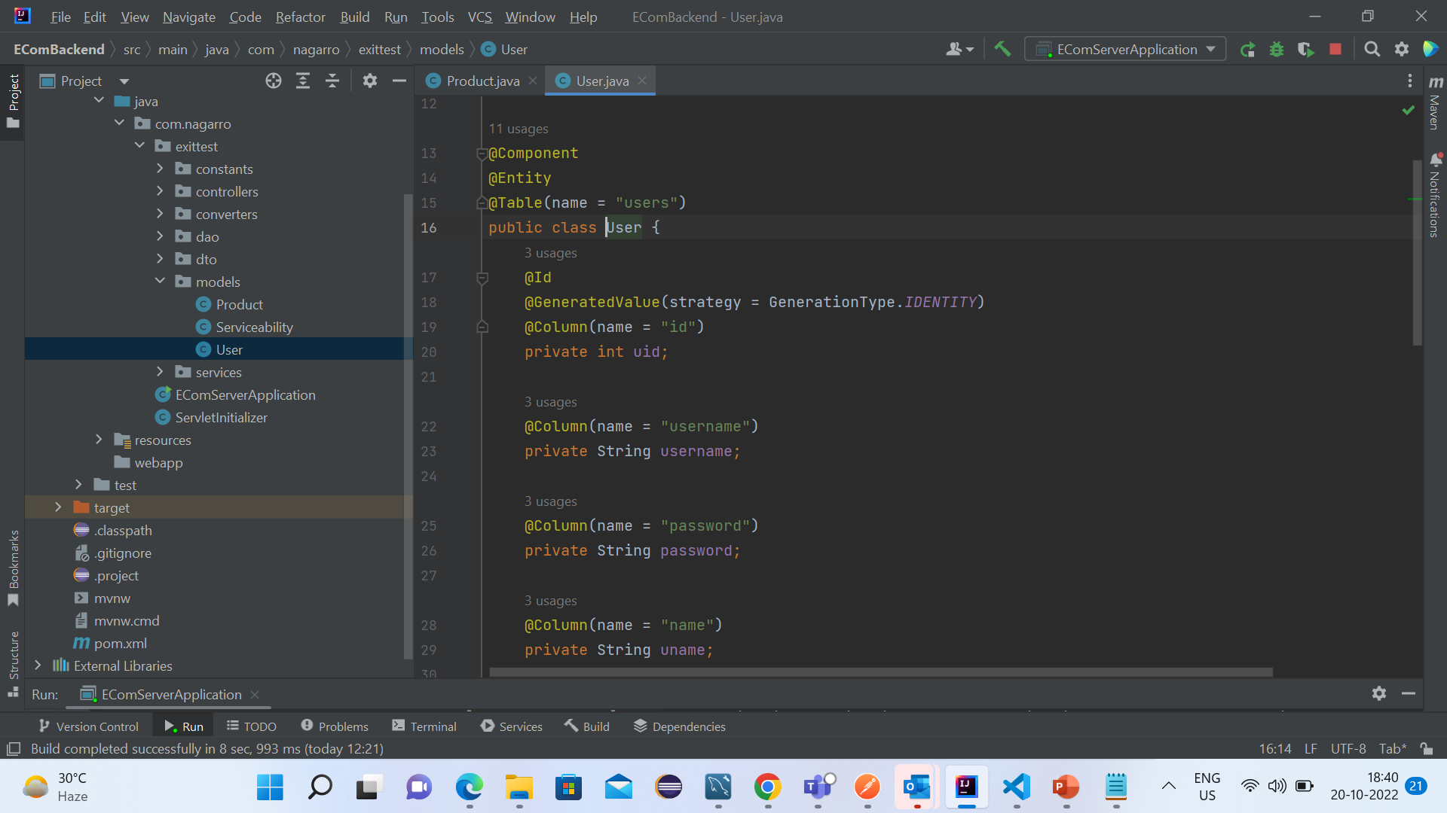
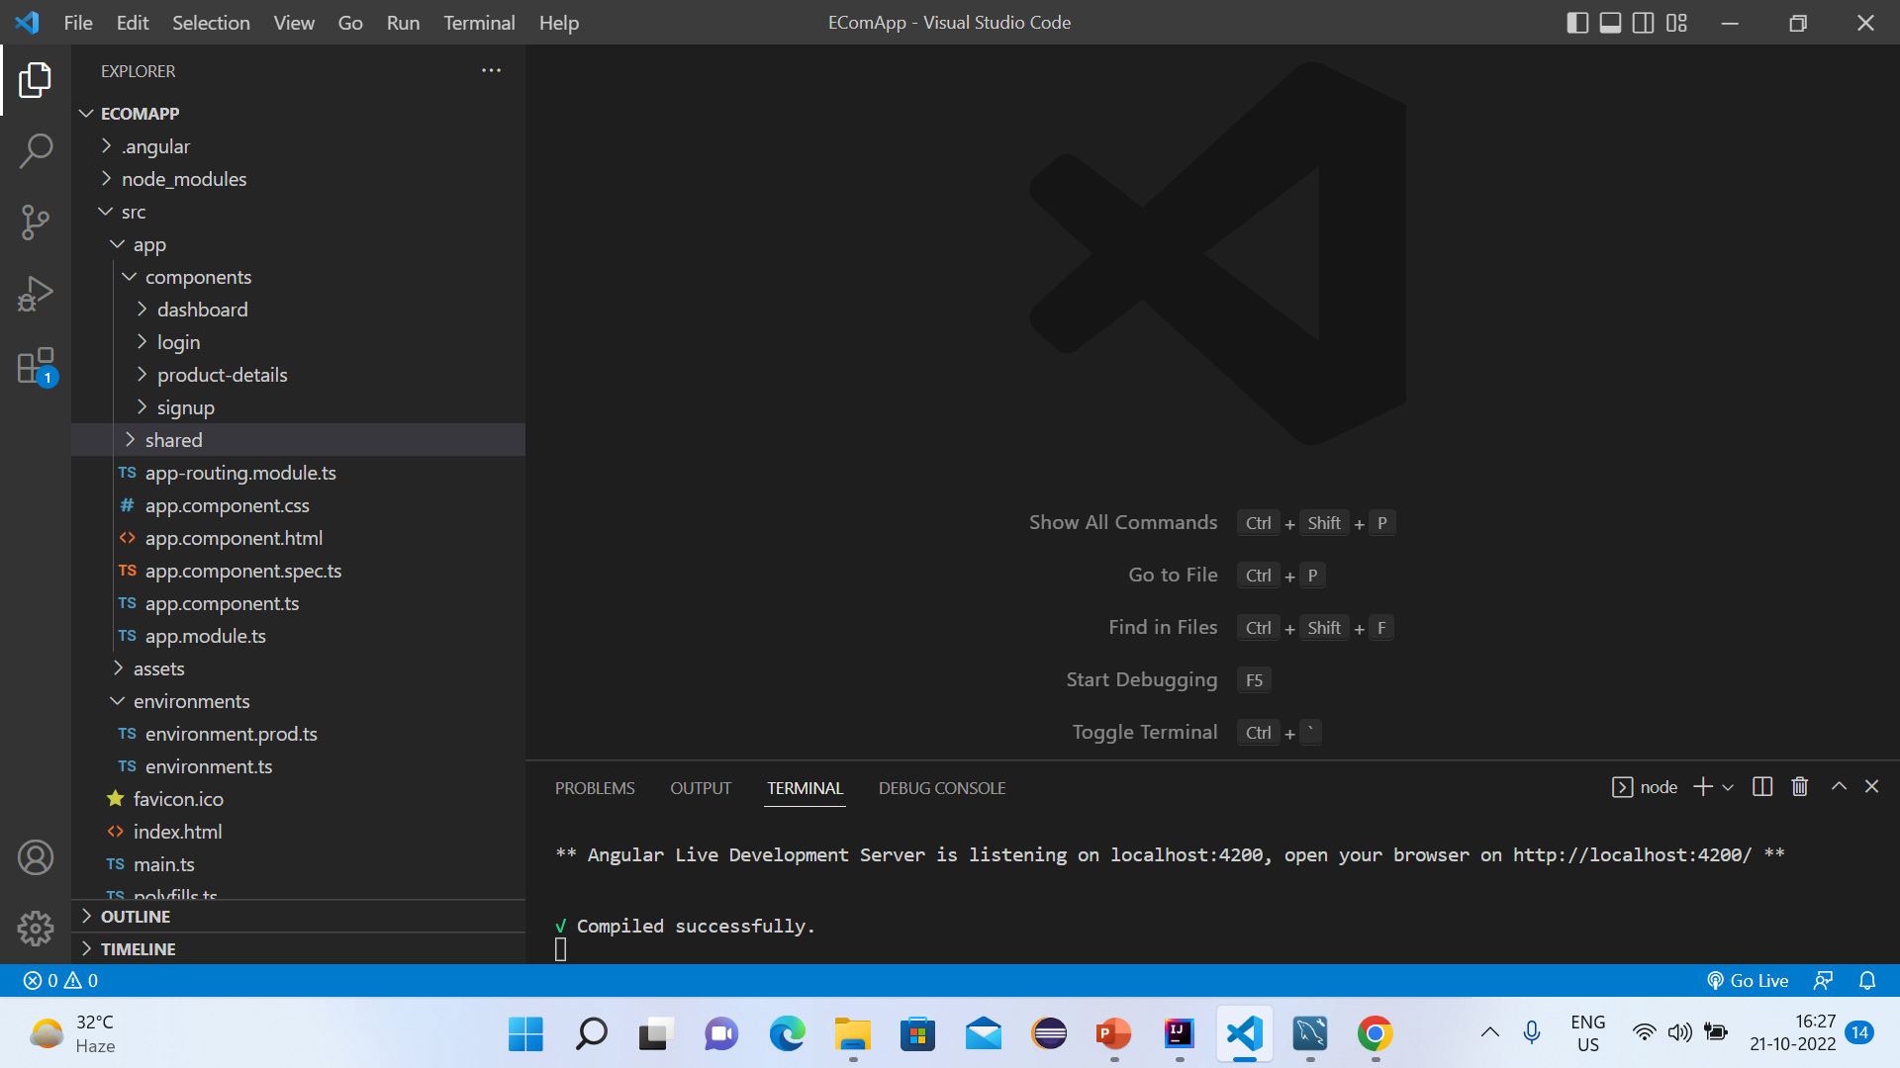

Slide 9
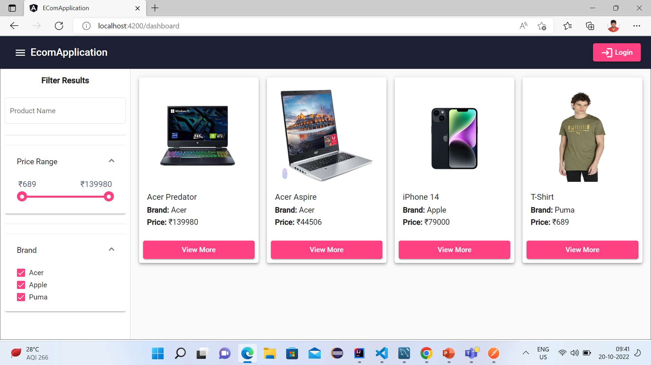

Slide 10
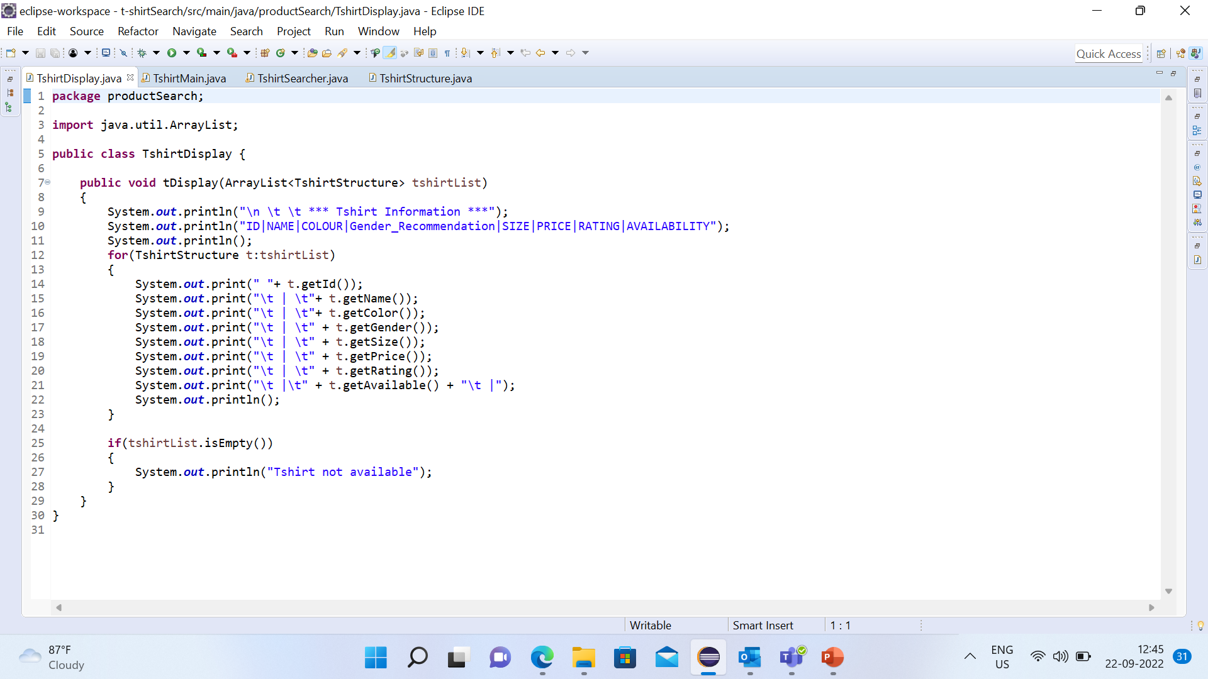
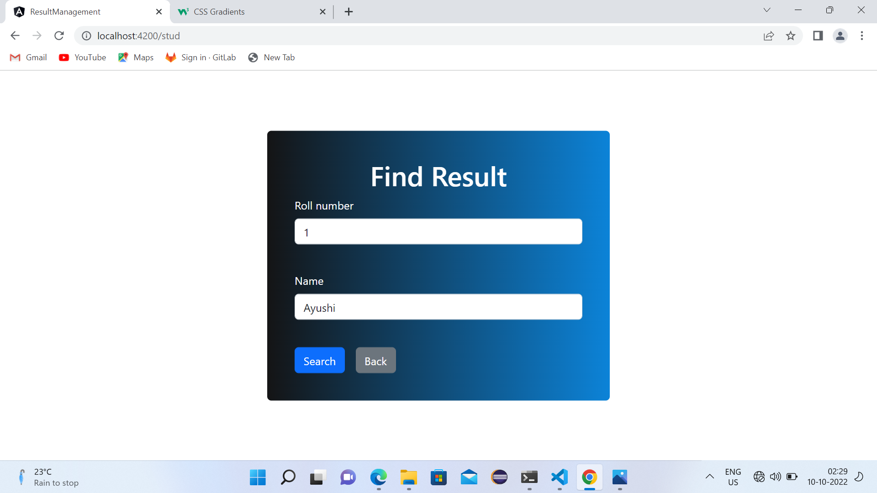
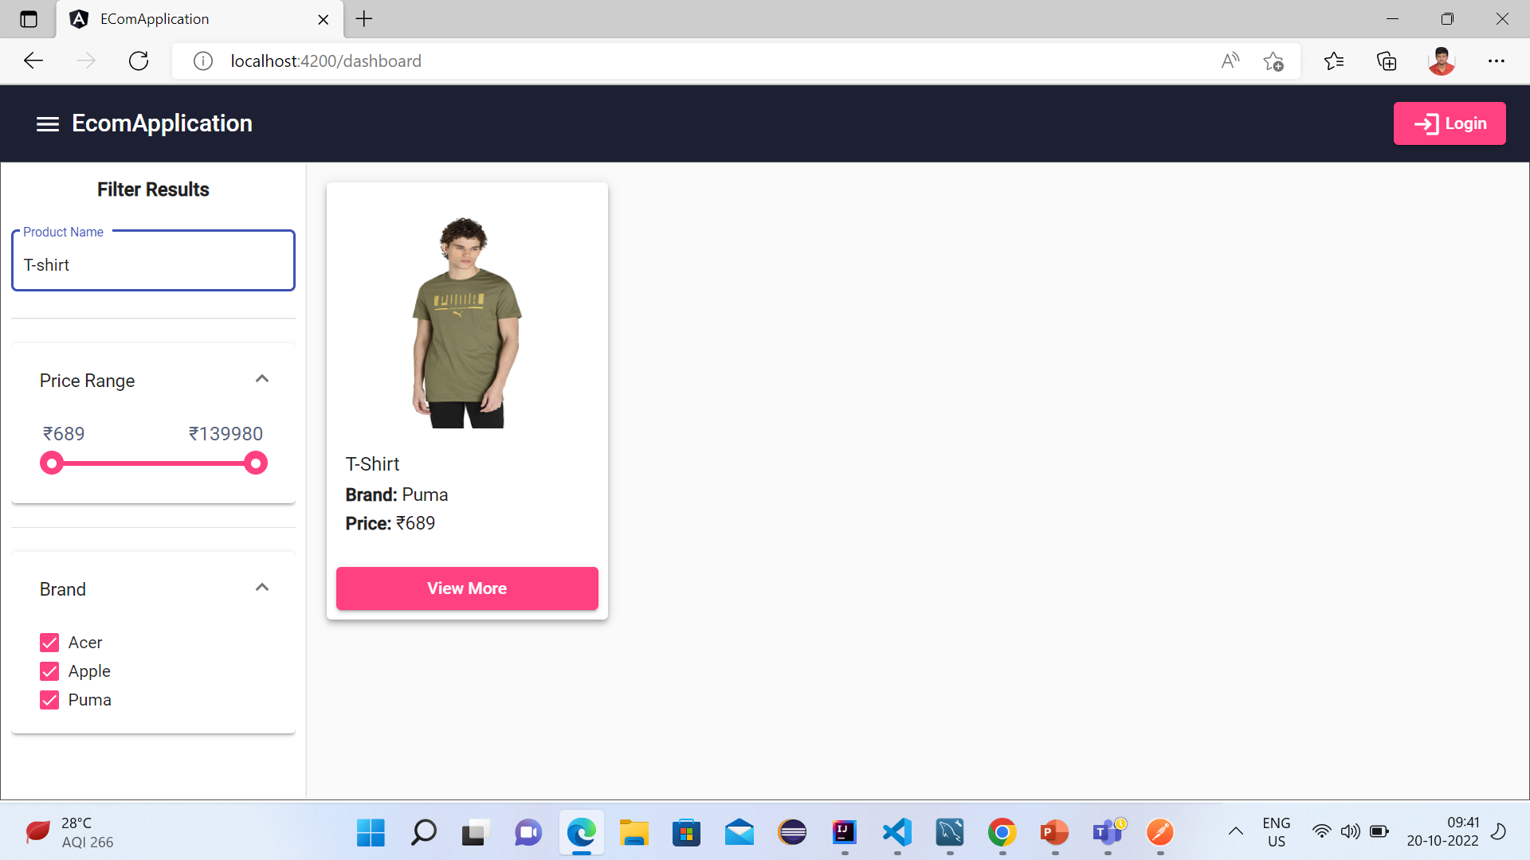

Slide 11
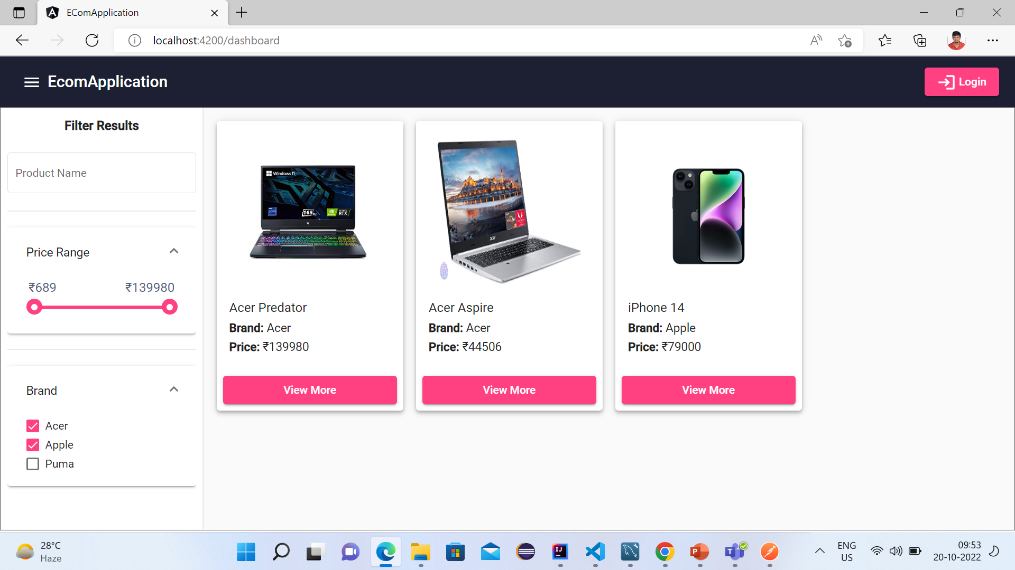

Slide 12
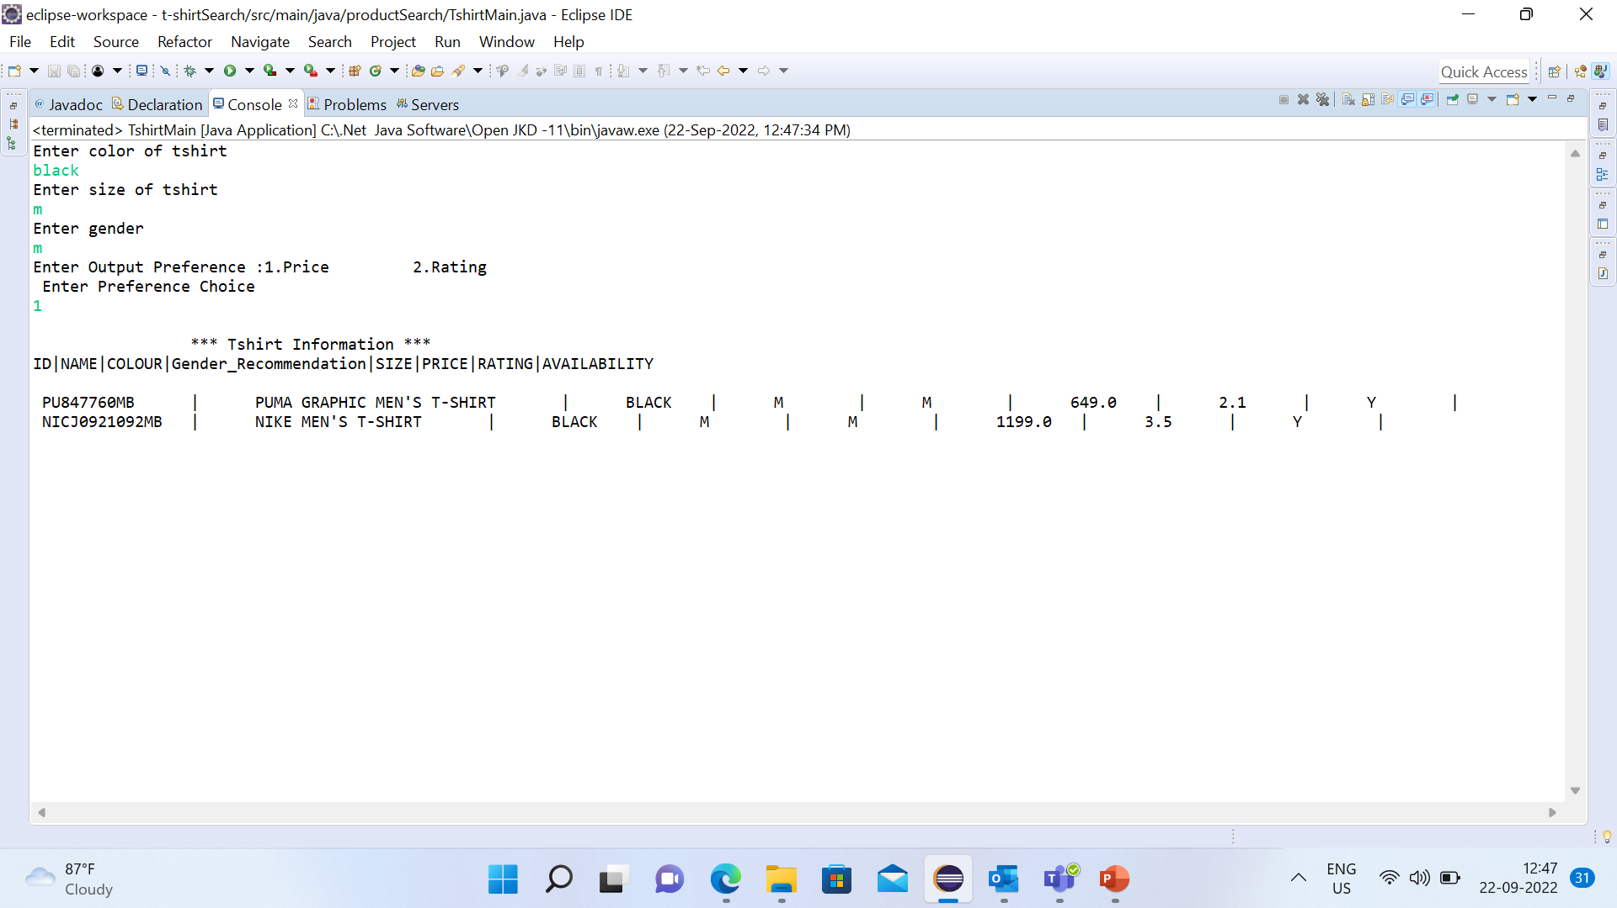
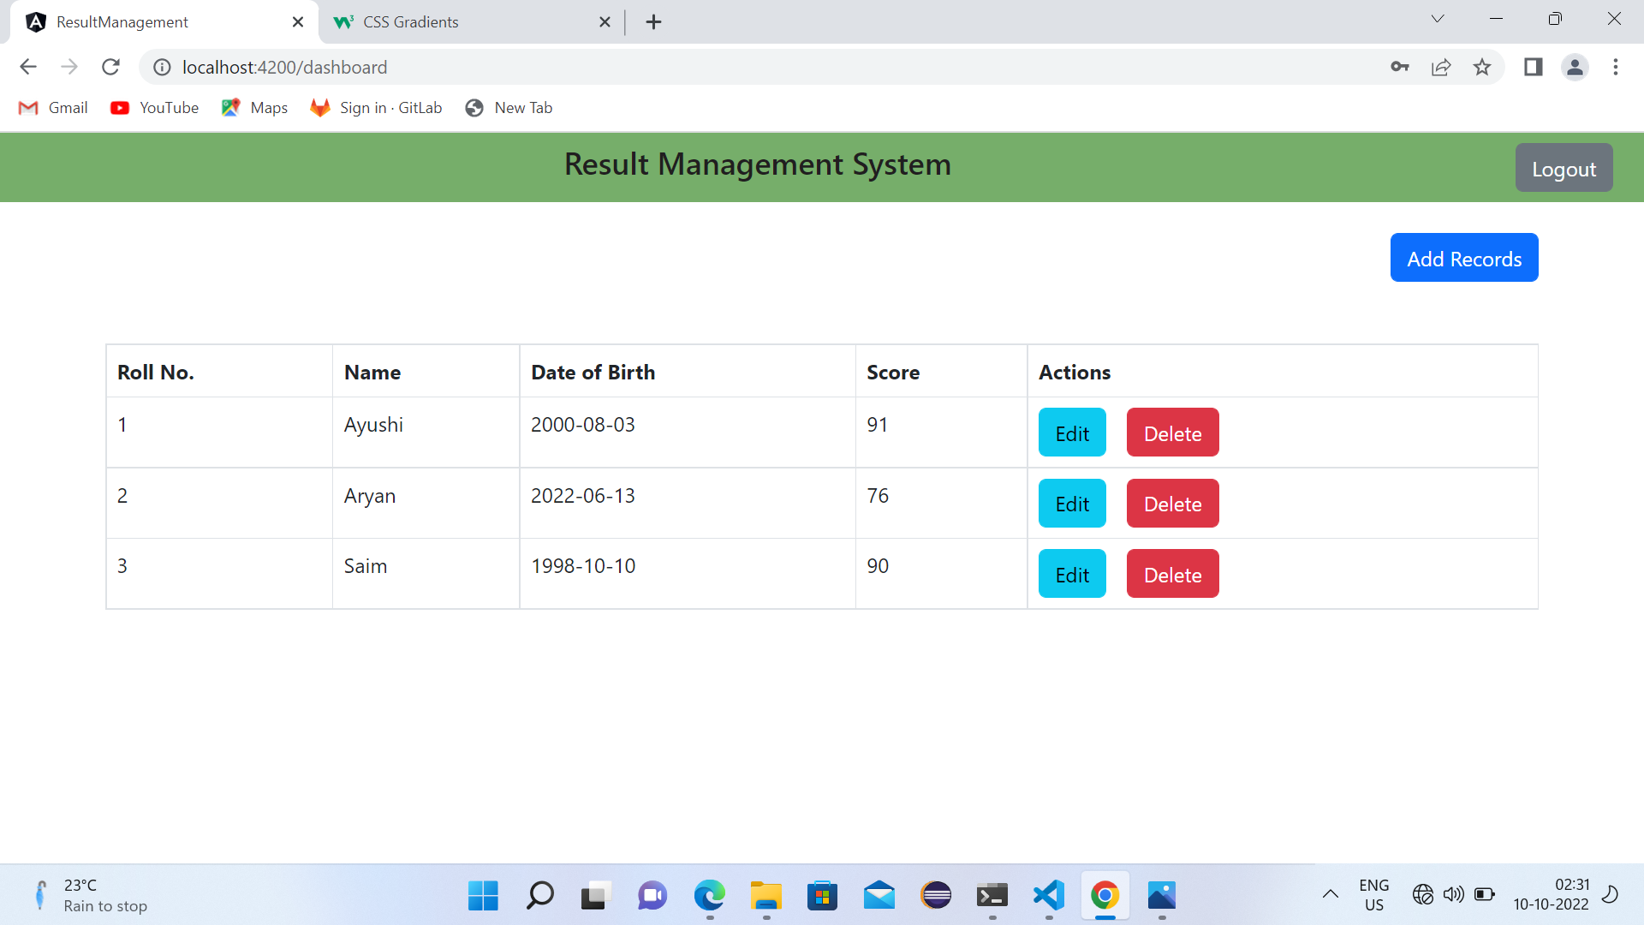
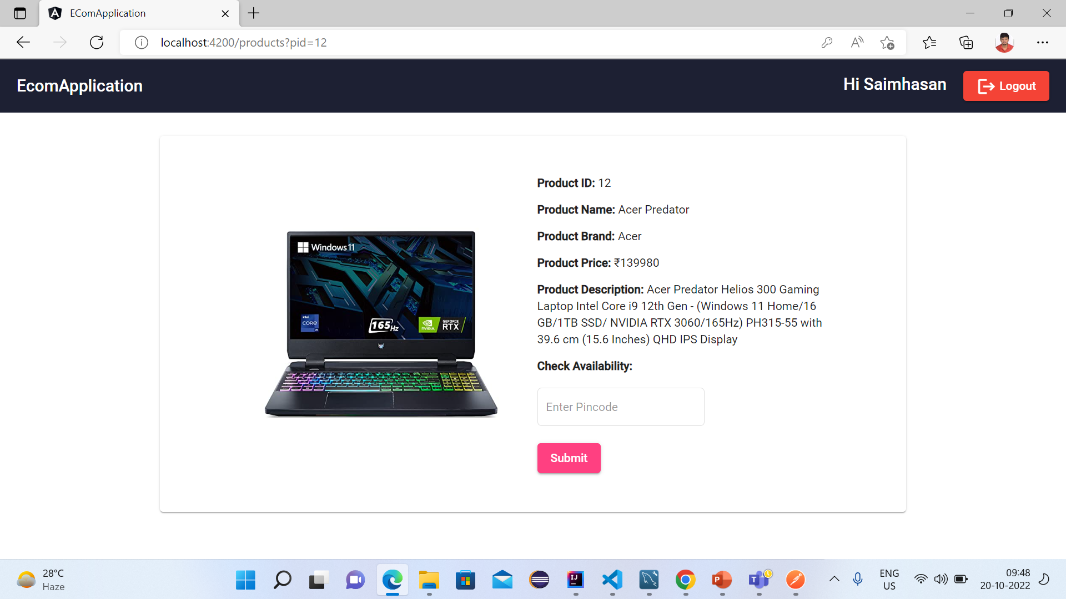

Slide 13
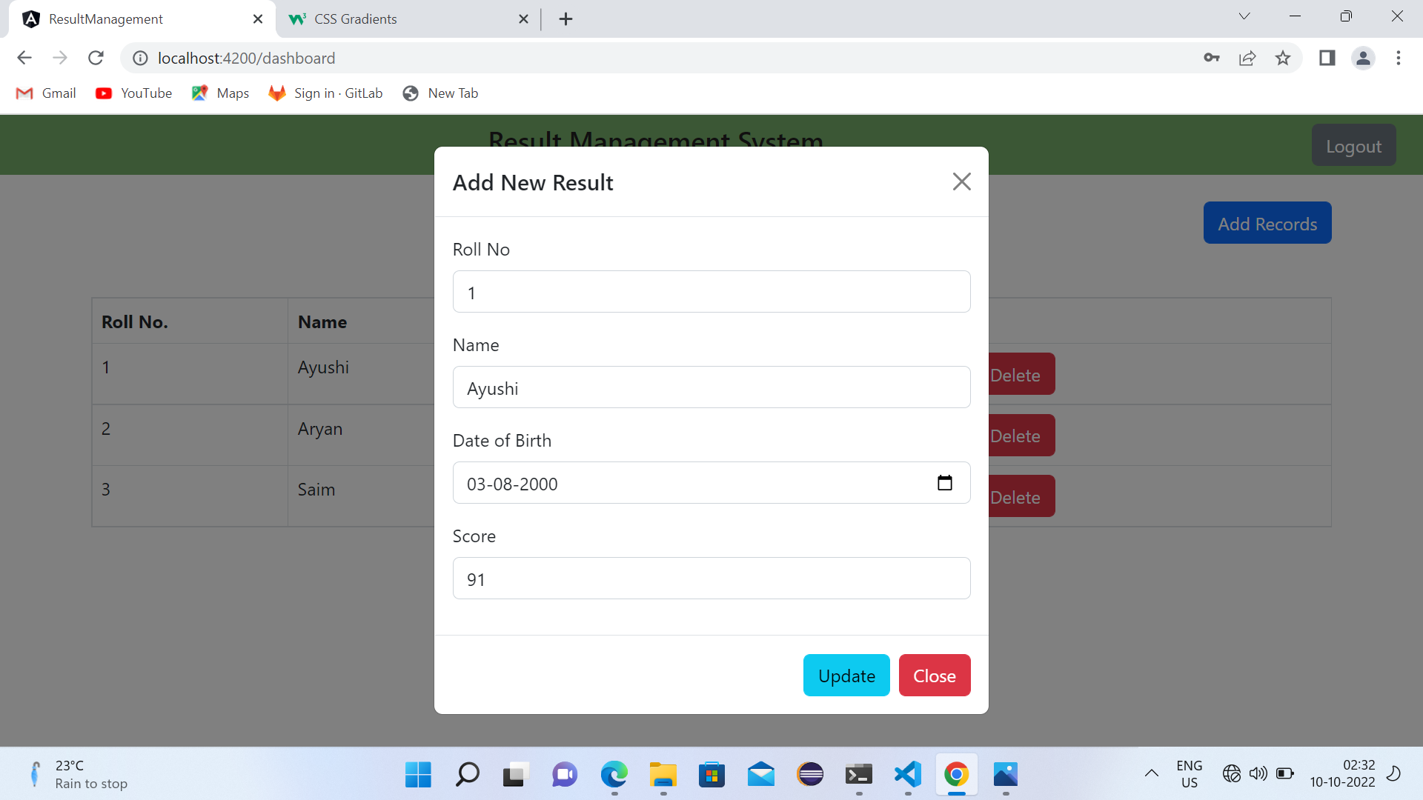
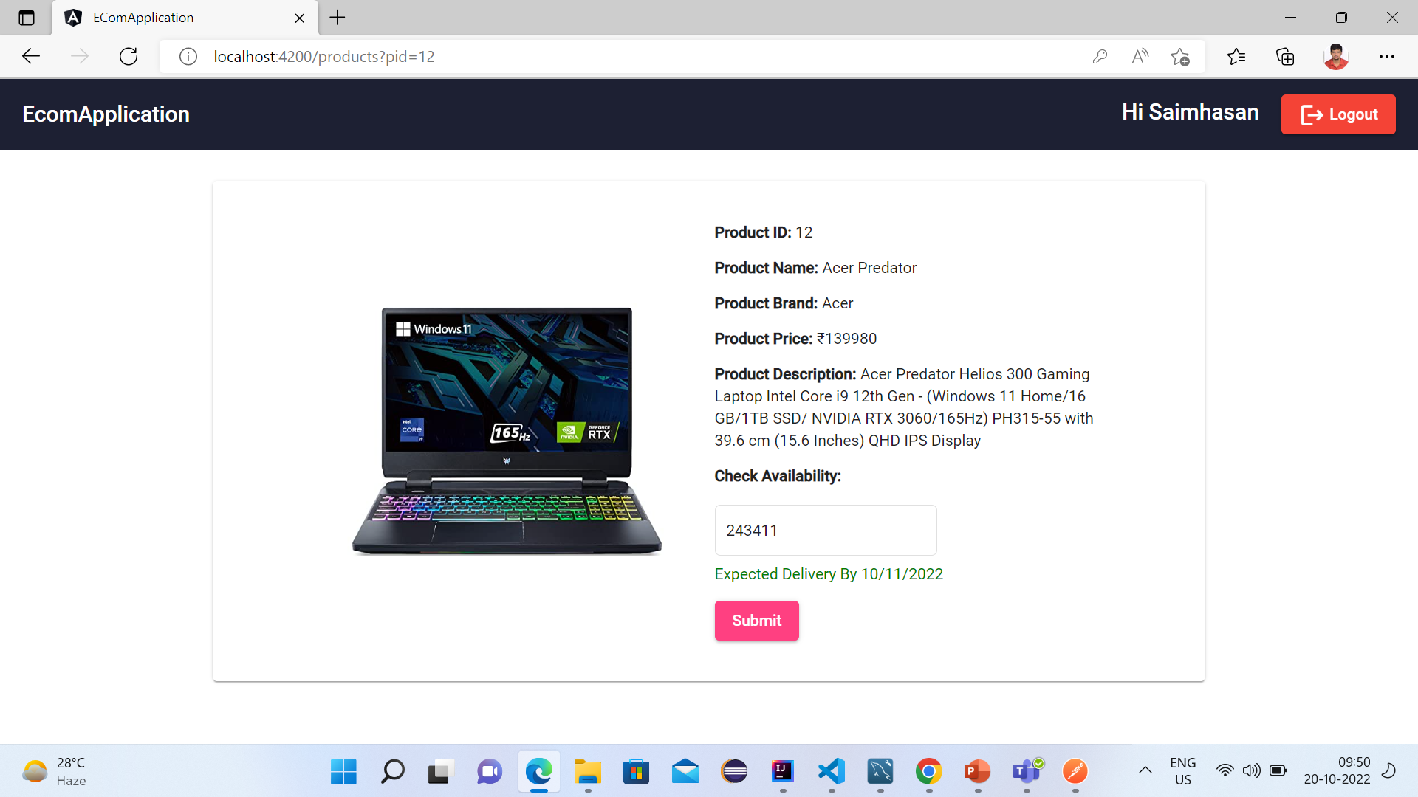

Slide 14
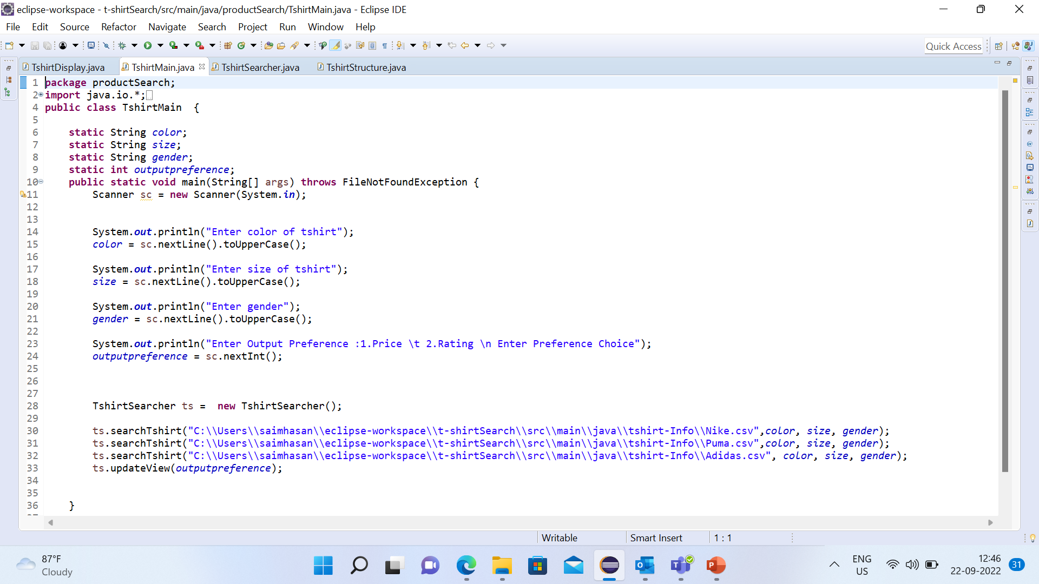
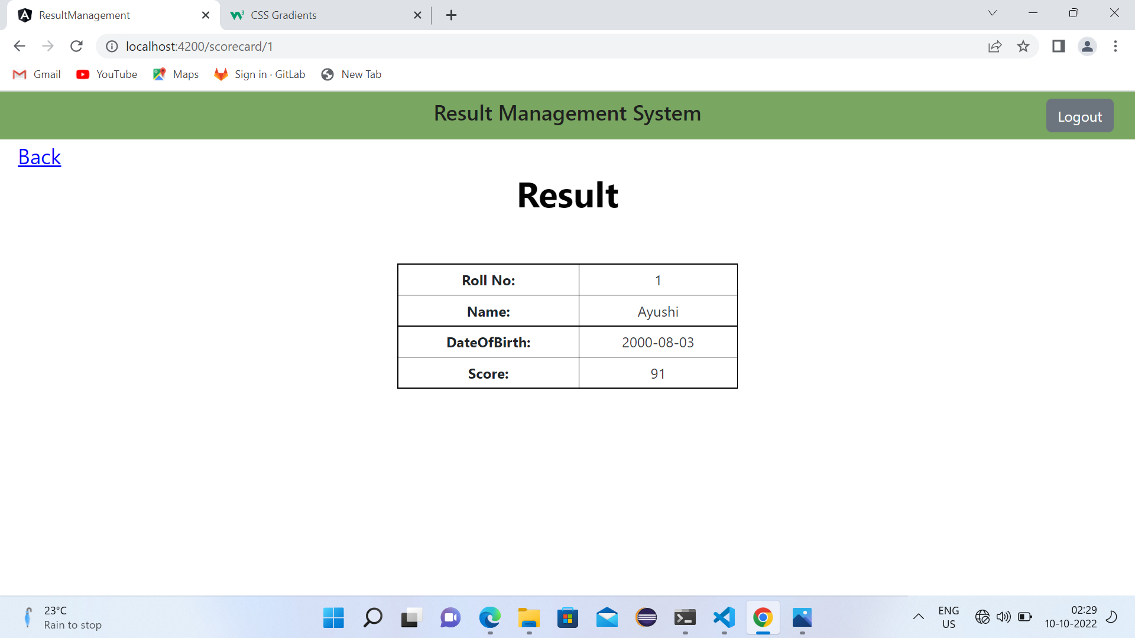
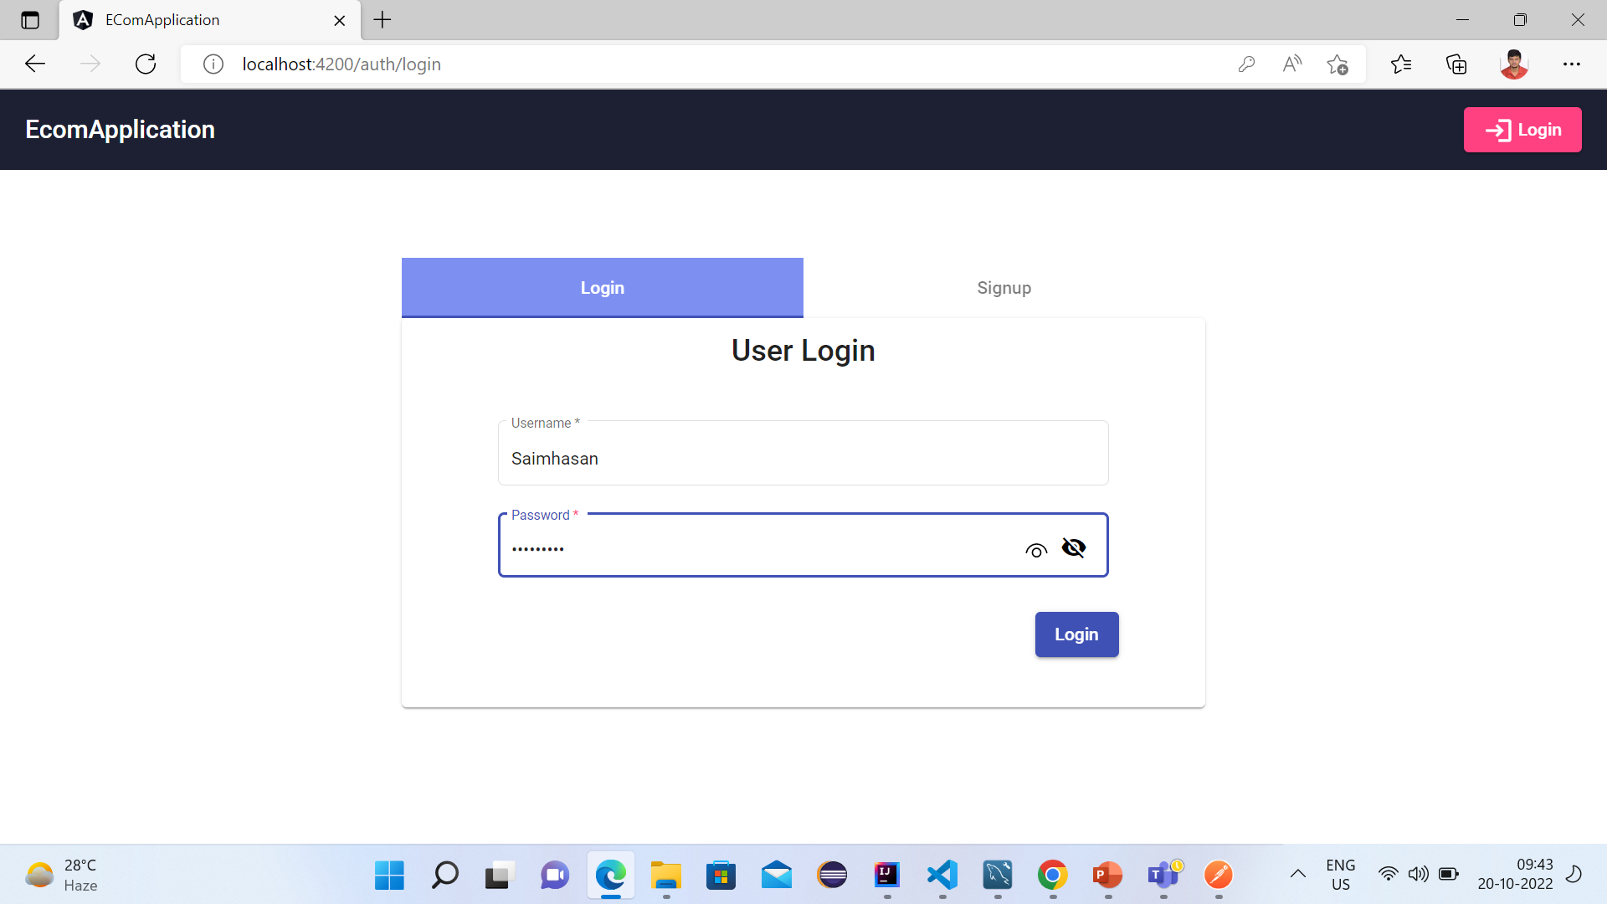

Slide 15
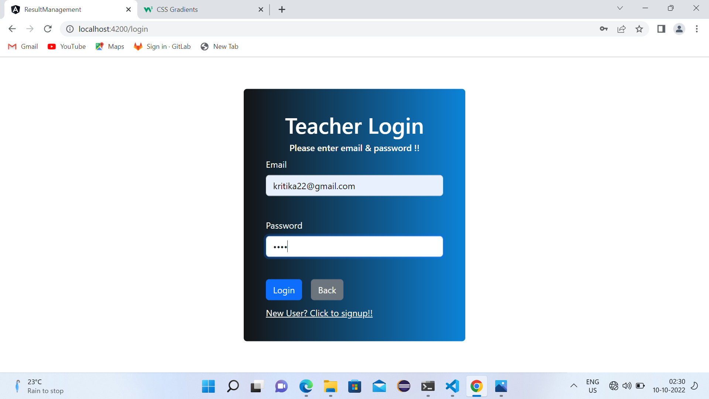
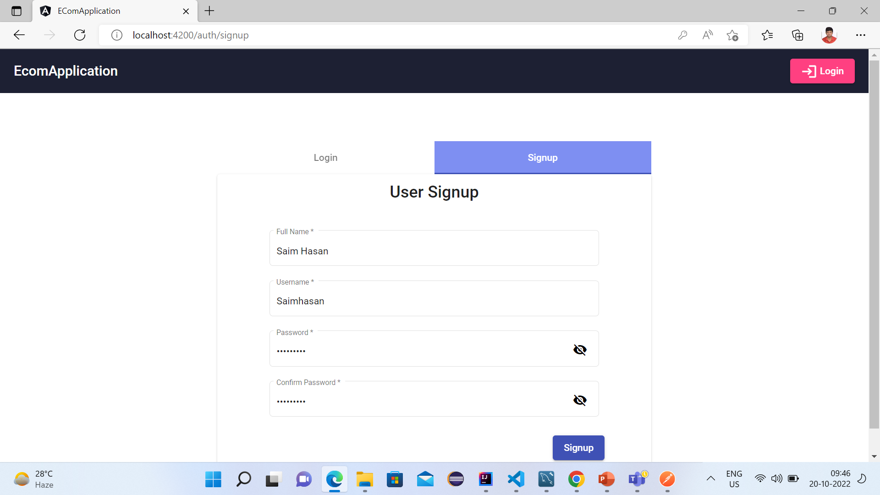

Slide 16
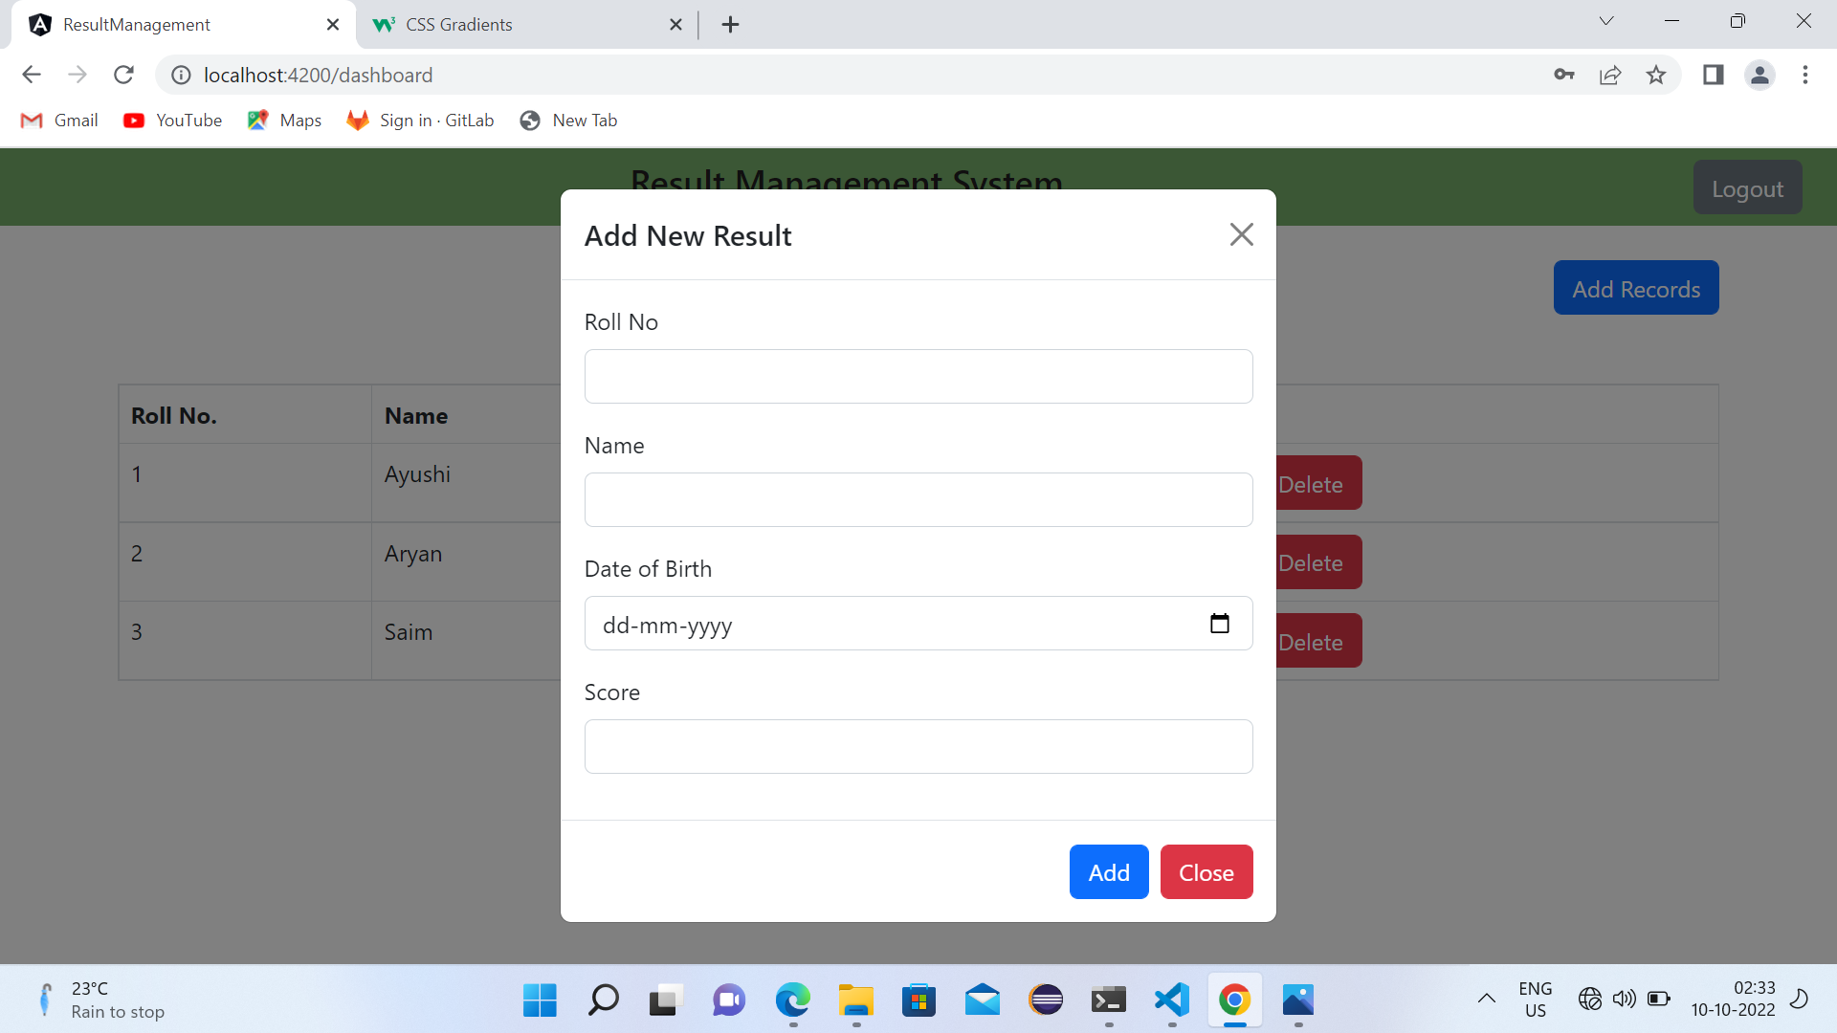
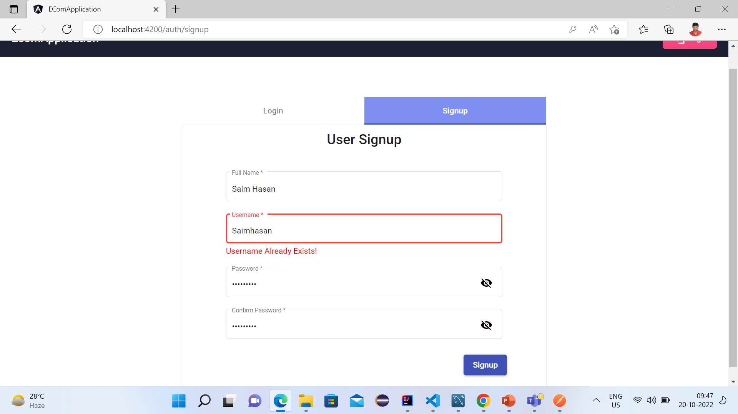

Slide 17
Approach

Slide 18
Product Catalogue Application
Database
Components
Services
Request
Controller
Services
DAO
Response
Module
Front End
Back End

Slide 19
Two applications are developed, Backend is created using IntelliJ and Frontend is created using Angular on VS-code.
In Backend, 3 POJOs are made such as users, products, serviceability which will map to 3 tables in database exit-test.
Two controllers are made one for user signup/verification and other related to product operations via different handlers.
Two services, product and authentication are used which will accept request from different controllers and interact with the database via Dao.
In Frontend, 4 major components and one header component are created which will manage navigation between the four components.
In dashboard component, we can filter products based on product name, price range and brand by default it display all the products.
Login component verify that the current user is valid user, if not a valid user proper error message will display.
Signup component is used to register new users.
Product details component is used to give full description of the product and tells that a product is deliverable at a particular Pincode.
Product service is used to hit the request to Product Controller.
User service is used to hit request related to user registration/login.
App routing module is used to navigate between different components.

Slide 20
Thank You

